Slide 1
Reconstruct data stacks

Slide 2
Instructions
For each company, put the tools in the right box to rebuild their modern data stack and specify in the lower part of the diagram how many engineers and people you need in each key position to run this data stack.
🎯 Objectives: This exercise will lead you to reconstruct data stacks with different degrees of maturity depending on how long you have been working on the data, as we see in this timeline 👇🏽
0 - No data (0 year)
1 - Discovering data (<1 year)
2 - Exploring data (1 year)
3 - Spreading data awareness (2-4 years)
4 - Distributing data knowledge (>=5 years)
5 - Decentralising data
aka Data mesh

Slide 3

Circle
ℹ️ “Circle is a young company that does not yet have a data or IT team. However, like all companies, we have to process data every day. We manually extract data from our logistics provider. The sales team enters orders on Google sheets (1) while customers can request a refund via a Google form. Google Analytics (1) tracks visitor data for the Prestashop-hosted site. We centralize the data on several Google Sheets (2) and perform the calculation and enrichment of the data on these Google Sheets (3). To export data from the data sources to Google Sheet, we do it either manually or with n8n (1). To return data from Google Sheet to commercial tools, we try to use n8n (2) as much as possible. We analyse and visualise our data on Google Sheets (4) with the exception of traffic analysis which we do directly on Google Analytics (2).”

Slide 4





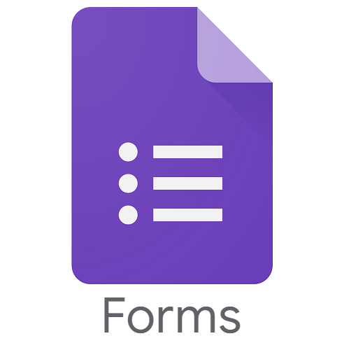

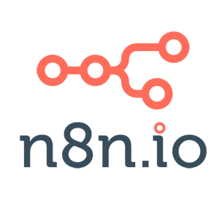

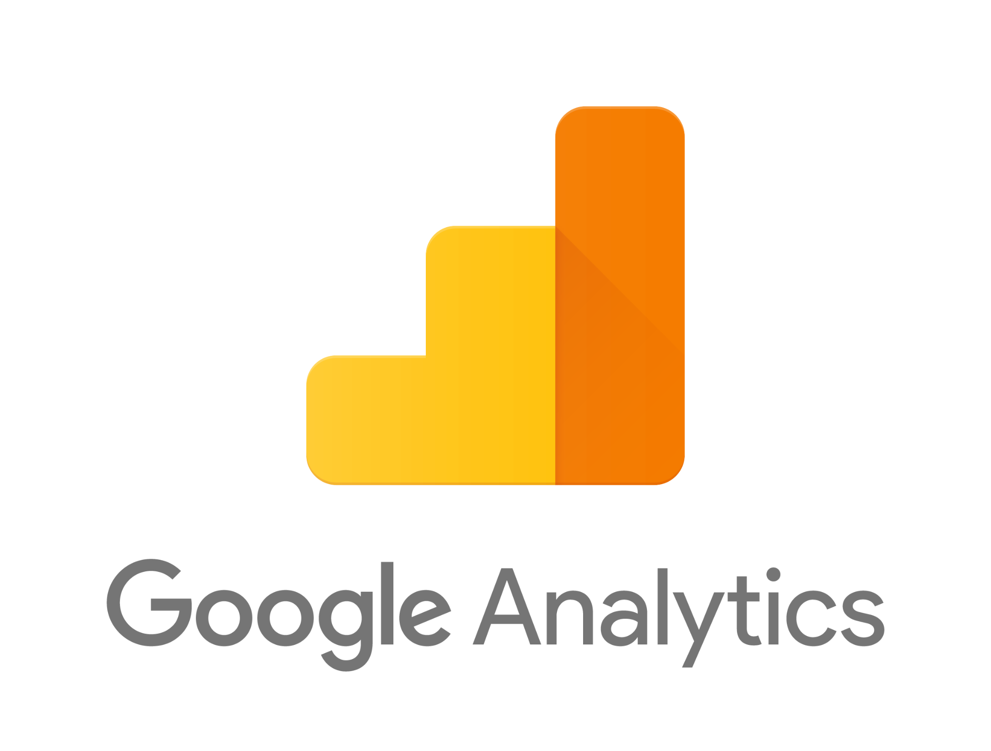











Circle
Data sources
Data platform
Reverse ELT
Activate
BI
E&L
Transform
Analyse
Orchestrate
Documentation
DE
DA
0
1
D.Ops
AE
BA
0
0
1 OU 2
DS
0

Slide 5

AssoConnect
ℹ️ “At AssoConnect, we primarily extract our data from computer databases stored on MySQL Azure. Rudderstack allows us to track our product usage more accurately than Google Analytics. Hubspot and Intercom are used by the sales and customer relationship management teams. We use Fivetran and Stitch to upload data to BigQuery depending on the data source and volume. Dbt allows us to model the data which is then viewed either on Tableau for in-depth analysis or on ReDash for operational reporting. To activate the enriched data to our business tools, we do not yet have a specific tool. We develop custom scripts.”

Slide 6




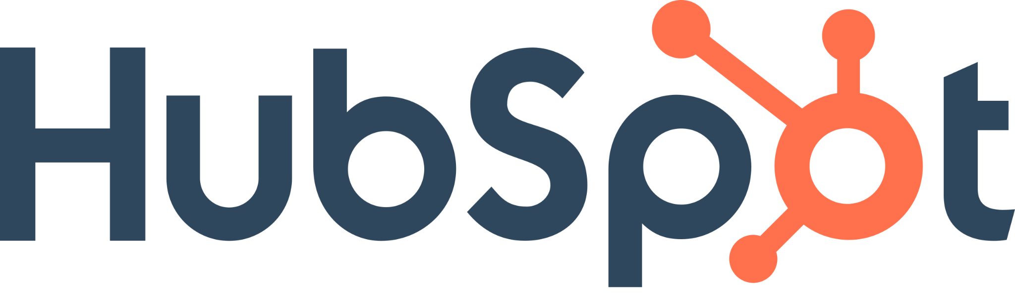






AssoConnect
Data sources
Data platform
Reverse ELT
Activate
BI
E&L
Transform
Analyse
Orchestrate
Documentation
DE
DA
0
2
D.Ops
AE
BA
0
2
2
0 DS
0

Slide 7
Phenix
ℹ️ “The data culture is already very mature at Phenix. Early on, we understood the importance of gathering our data on a central data platform (BigQuery) and we have good internal monitoring through data visualisation on Looker. Not only do we use the data internally, but it is also essential for giving insights to our B2B customers. We use cumul.io for integrated analytics and visualisation for our clients. The value of data is not limited to visualisation and reporting. Enriched data models created with dbt are also communicated to business teams through Airflow (1) to be activated and provide value. We have many data sources. For example, finance is hosted on our Oracle Netsuite ERP while CRM is hosted on Salesforce. We use Amplitude for tracking and our application data is stored on Amazon Aurora MySQL tables. We use Fivetran or a script developed with Airflow (2) to connect them to BigQuery. Everything is documented on Notion”.

Slide 8






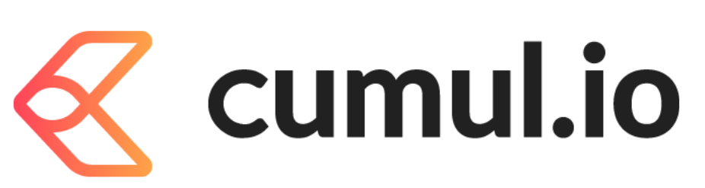

Phenix
Data sources
Data platform
Reverse ELT
Activate
BI
E&L
Transform
Analyse
Orchestrate
Documentation
DE
DA
2
4
2 D.Ops
AE
BA
2
4
4
DS
1

Slide 9

Greenweez
ℹ️ “Greenweez has many tools used by the business teams, these tools provide many sources of data. For example, Google Analytics for tracking, Salesforce for customer service, Odoo for accounting, Adyen for payments or Google Ads for advertising. Finally, the data team extracts a large amount of data from the MySQL server managed by the IT team. Airflow orchestrates the different steps of the data chain and the documentation is done on Confluence. Most connections to the BigQuery data platform are made via custom scripts (1) developed by the data team in python. Data modelling is done via Dbt and Datastudio is used for dashboards. To activate data to commercial tools, the data team has developed custom scripts (2) but is currently testing Retool”.

Slide 10








Greenweez
Data sources
Data platform
Reverse ELT
Activate
BI
E&L
Transform
Analyse
Orchestrate
Documentation
DE
DA
3
3
D.Ops
AE
BA
2
3
1
DS
2

Slide 11

Blablacar
ℹ️ “At Blablacar, we have many data sources. Among them, we can mention PostgreSQL, MariaDB, or Google Ads and Facebook for media ads. We use Kafka to create real-time data feeds from our data sources to our BigQuery Data platform. We have developed in-house tools to enrich our data through modelling and machine learning. Tableau is our BI tool and we do reverse ETL with custom developments. We do not use a specific documentation tool. What is worth mentioning is that we use a data observability platform (MonteCarlo) which allows for data observability, alerting and lineage. Airflow is our orchestration tool.”

Slide 12



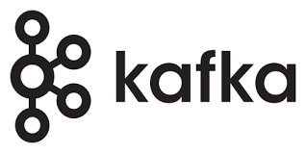
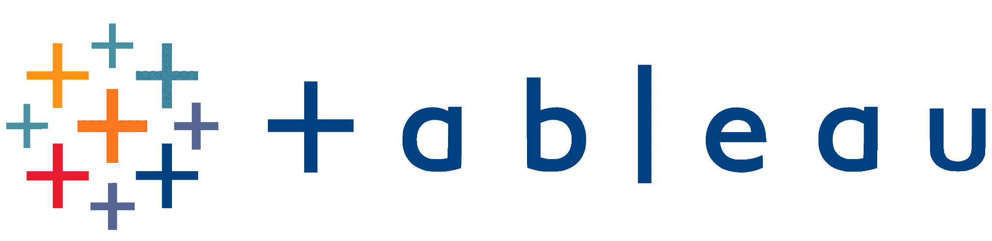


Blablacar
Data sources
Data platform
Reverse ELT
Activate
BI
E&L
Transform
Analyse
Orchestrate
Data observability
SQUADE 3

